Slide 1

MINI PROJECT- I
Project Title : OSFAP
Project Guide : Mr.B.Sivaiah
S.NO. NAME ROLL NO.
1. D.Sai Prasanna 19H51A0567
2. G.Chinmay Chidwi 19H51A0568
3. G.Suhasini 19H51A0569
4. G.Kiran Deepak 19H51A0570
BATCH NO. - 26

Slide 2

One Stop For All Plants

Slide 3
TABLE OF CONTENTS
Abstract
Problem statement
Existing models
Drawbacks of existing models
Proposed solution
Software requirements
Features
Workflow
Future scope
Conclusion
References

Slide 4
ABSTRACT
The drastic changes that have taken place across the globe in the past few years has changed the entire lifestyle of human beings. The major part of work is done online. Considering the present changes in the scenario, we decided to design an online plant selling website.
The name for this website is OSFAP (One Stop For All Plants). The website contains login page, buyer and seller activities that can be performed, description of each plant, reviews etc.

Slide 5
PROBLEM STATEMENT
To create a website that enables users and sellers to purchase and sell plants, i.e. an online nursery. The website must include relevant information about the plants along with reasonable prices and various payment options. It must also allow customers to purchase rare plants and provide necessary reviews.

Slide 6
EXISTING MODELS
Online Flower Delivery | Send Flowers To India | Best Flower Shop
https://www.floweraura.com/
Bloomscape | Home Ready Plants Delivered to Your Door
https://bloomscape.com/
Official UrbanStems - Flower & Plant Same Day Delivery » NYC, DC & Nationwide
https://urbanstems.com/
eBay: Electronics, Cars, Fashion, Collectibles & More
https://www.ebay.com/

Slide 7
DRAWBACKS OF EXISTING MODELS
No direct access to vendors
Multiple vendors are not supported
High shipping charges
Involvement of third party delivery
No two step authentication
Non availability of rare plants

Slide 8
PROPOSED SOLUTION
We created a website called One Stop For All Plants (OSFAP). This helped us overcome the drawbacks in the existing models as :
It supports multiple vendors and provides direct access to vendors
Includes secured payment methods
Rare plants are available
Scientific names are provided for each plant
Mandatory information fields must be filled by vendor before uploading their plant

Slide 9
SOFTWARES USED
Front end
React
1
Back end
Express.js, Node.js
2
Database
MongoDB
3

Slide 10
FEATURES
Login/Registration
Email verification
Store
Shopping cart
Payment gateway
Past orders
Delivery

Slide 11
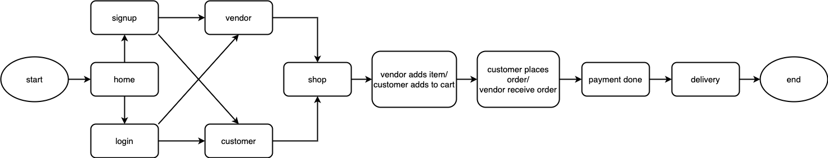
WORKFLOW

Slide 12
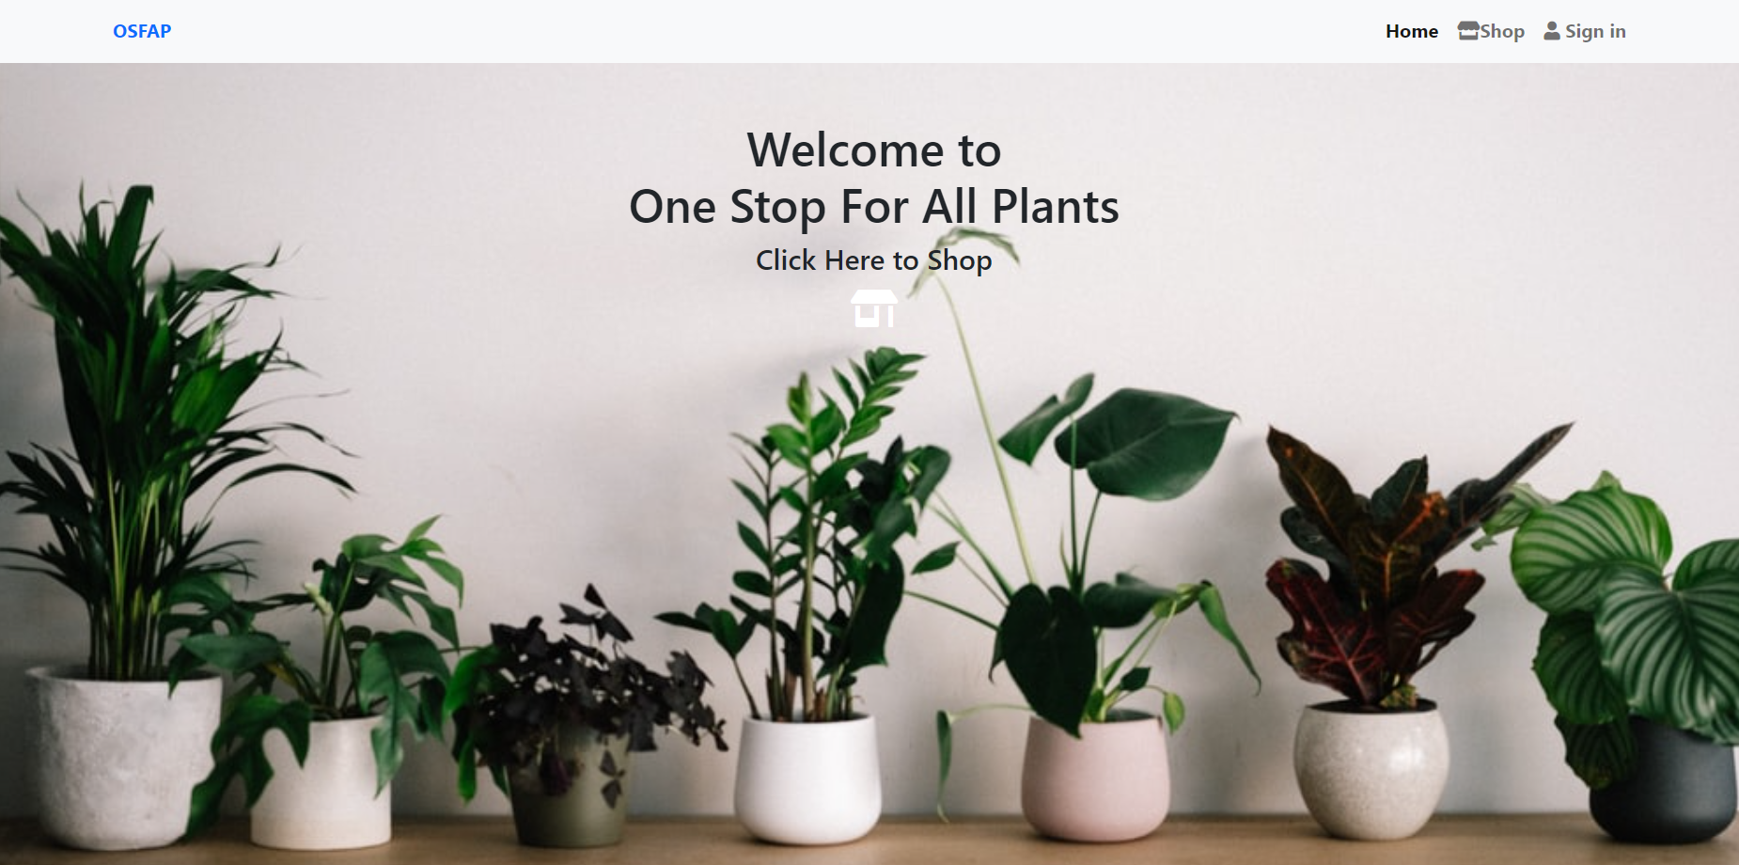
USER INTERFACE
Home page:

Slide 13
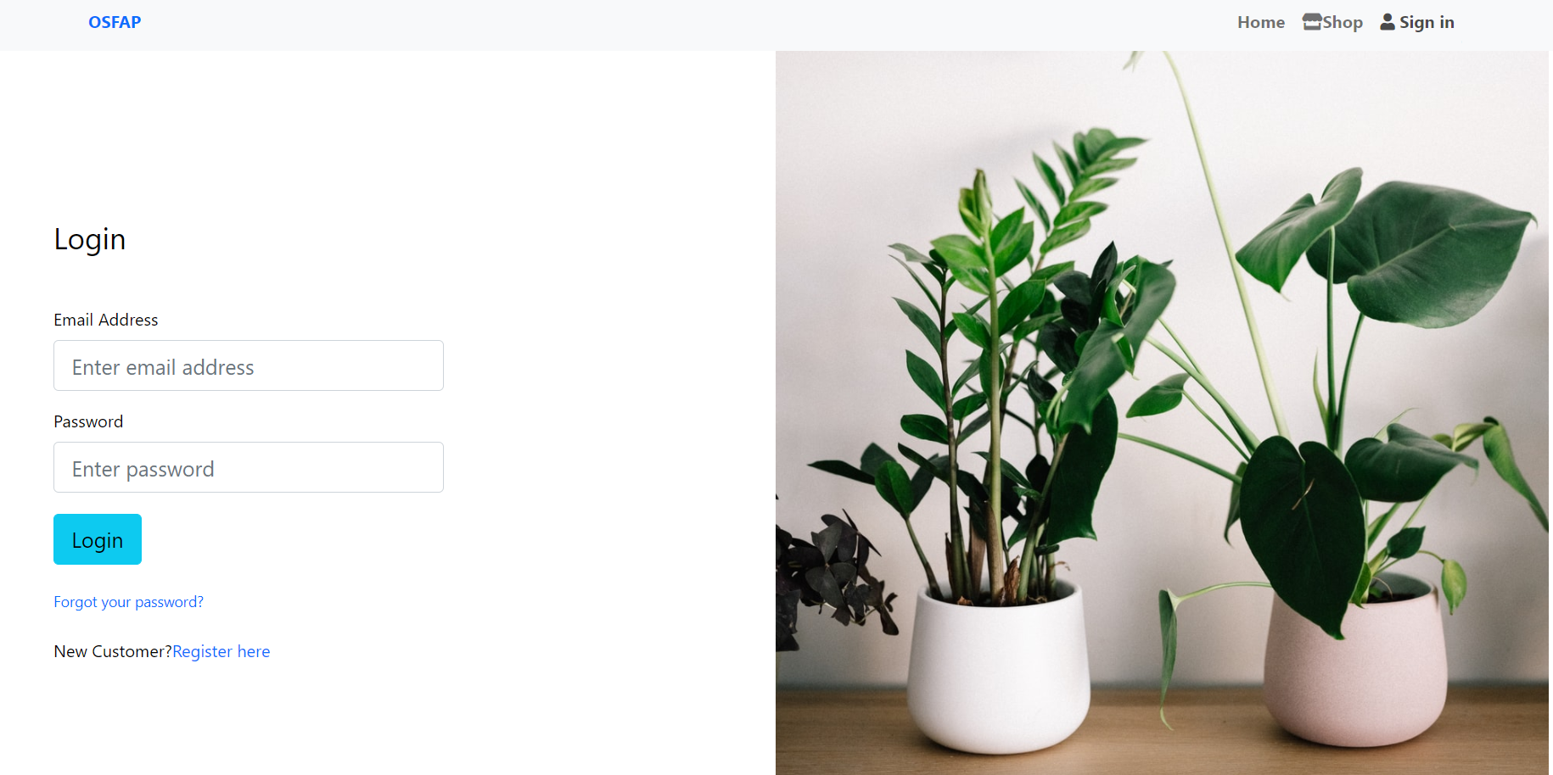
Login Page:

Slide 14
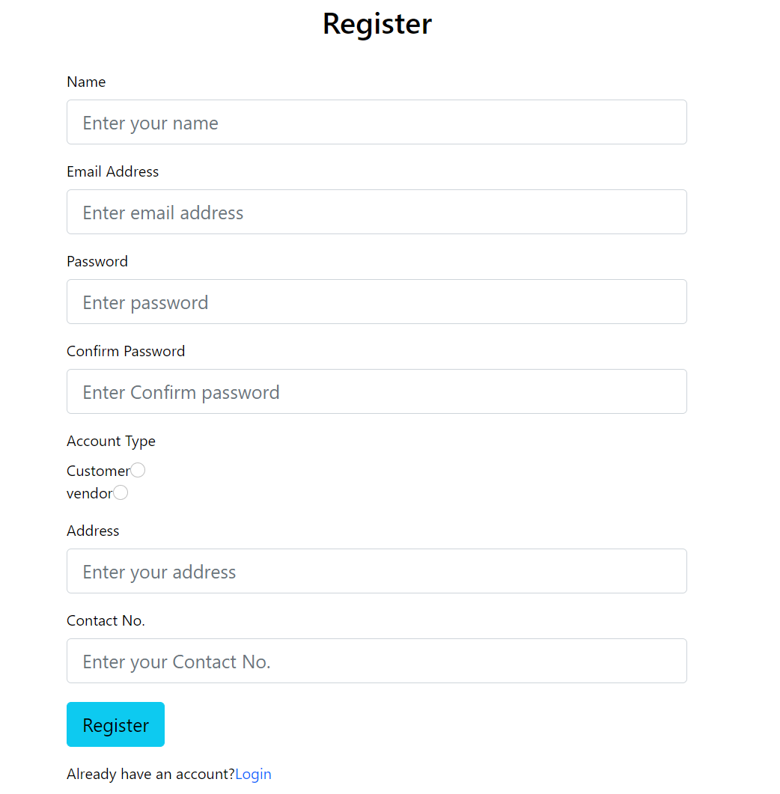
Registration page:

Slide 15
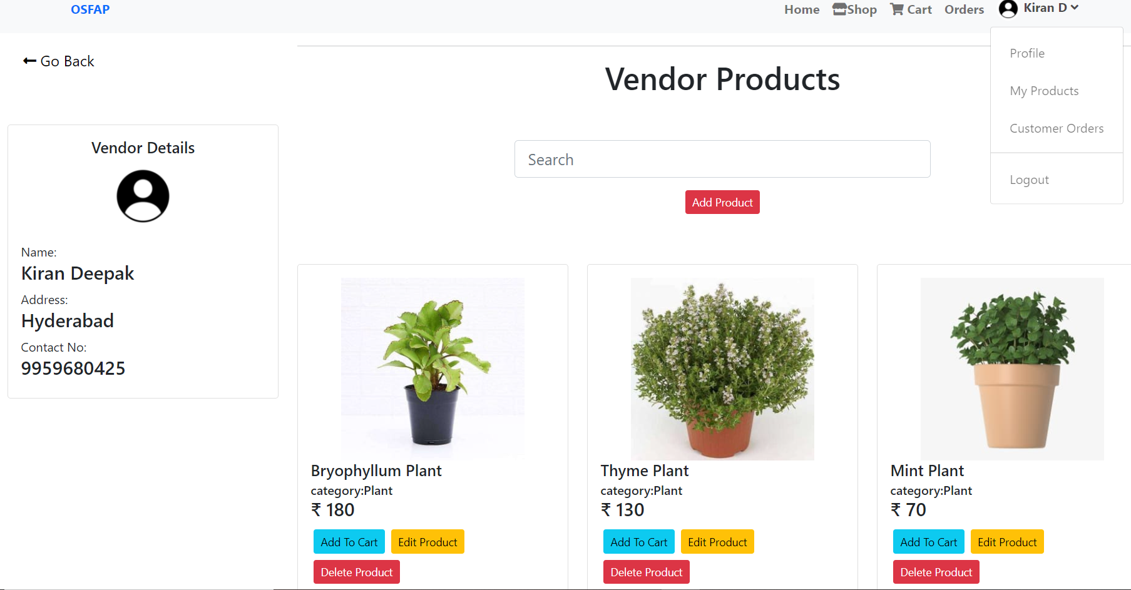
VENDOR PROFILE

Slide 16
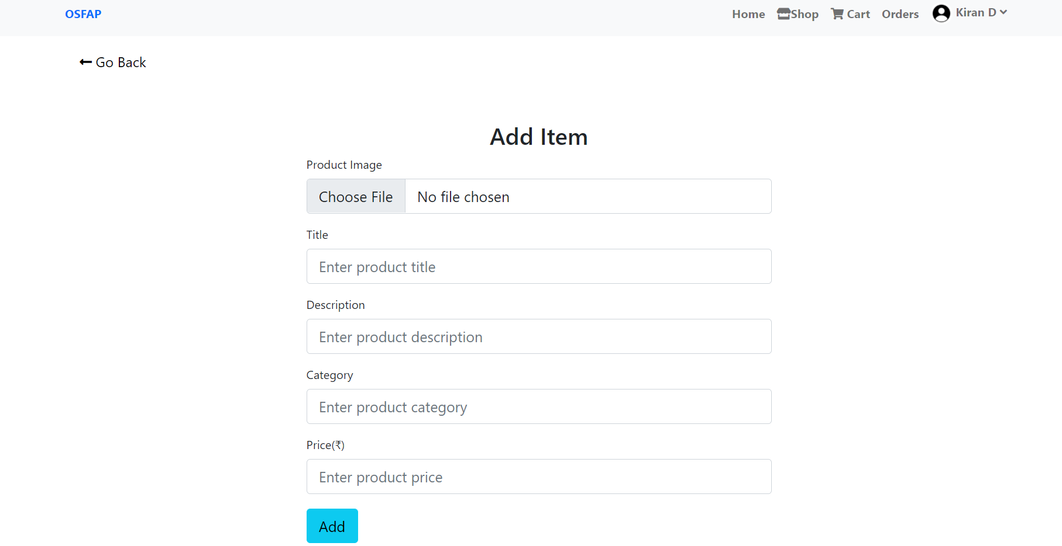
Adding plant’s information:

Slide 17
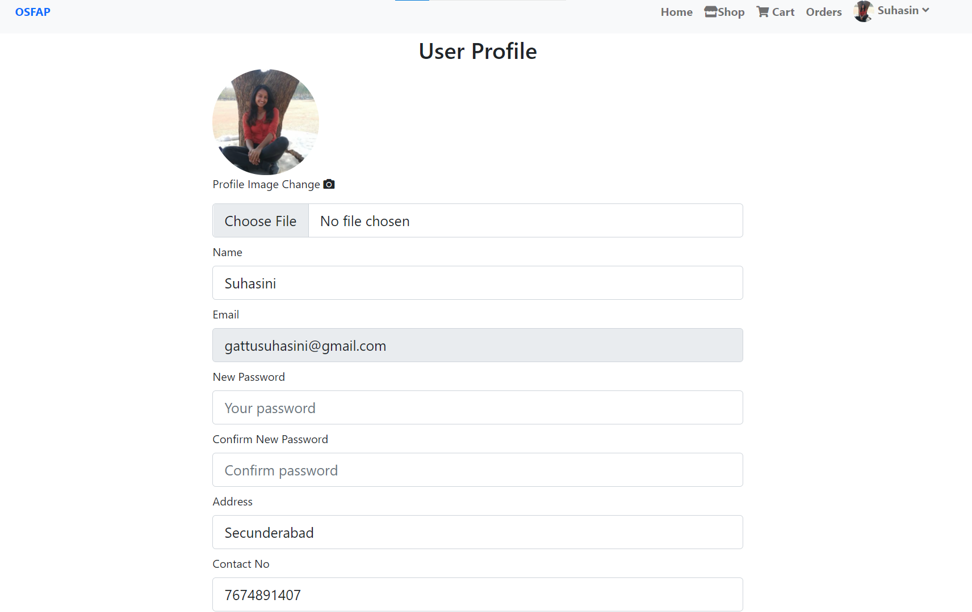
CUSTOMER PROFILE

Slide 18
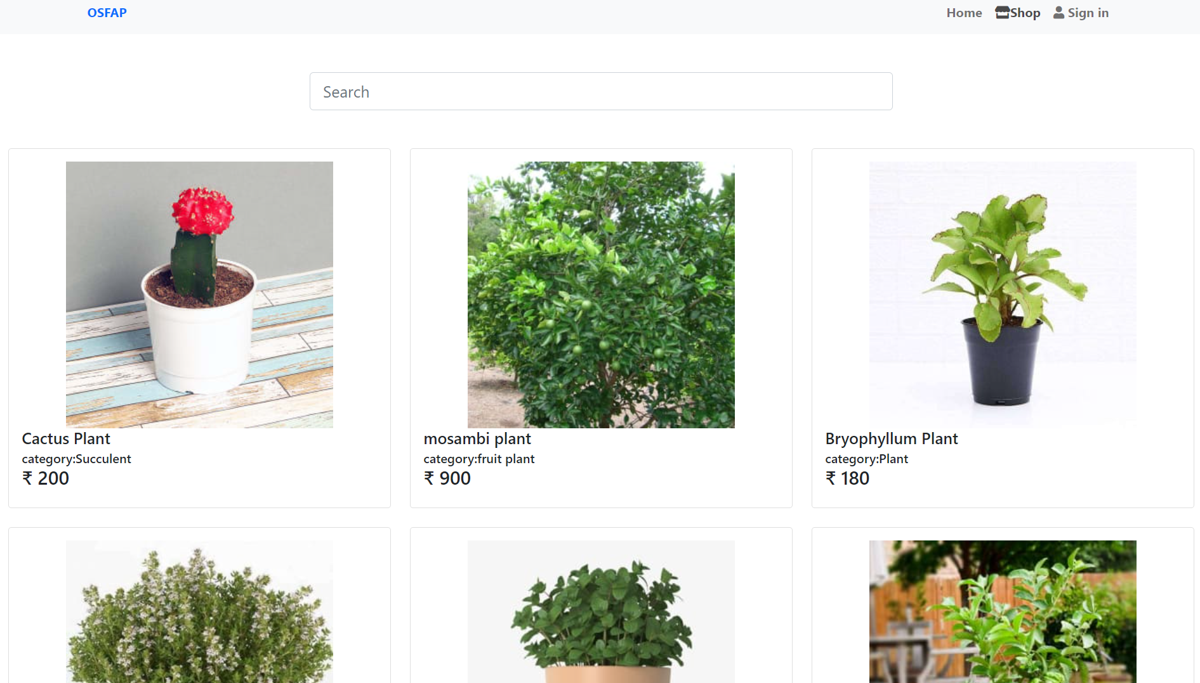
Store:

Slide 19
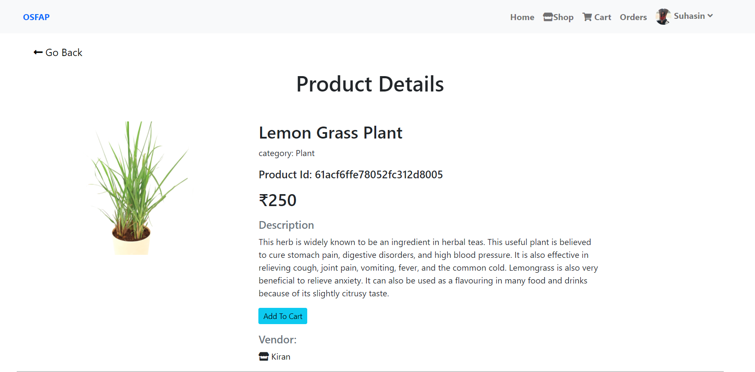
Product Details:

Slide 20
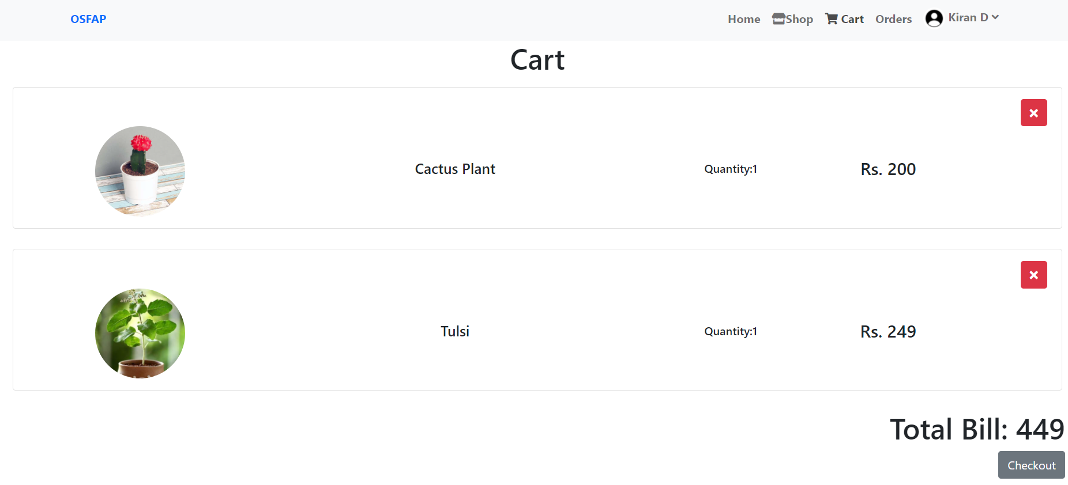
Shopping Cart:

Slide 21
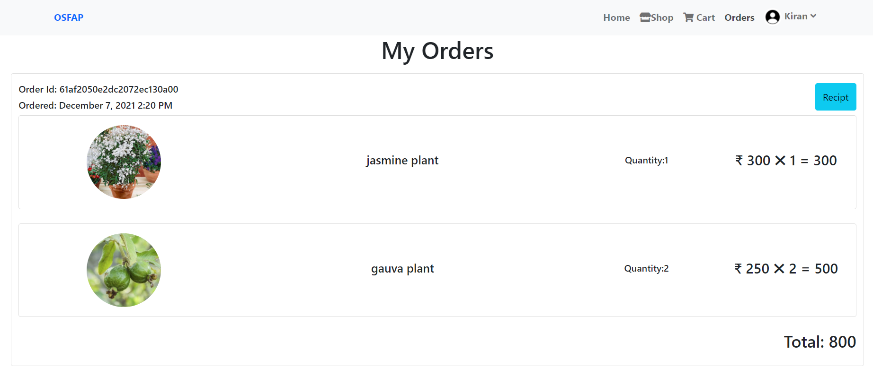
Orders:

Slide 22
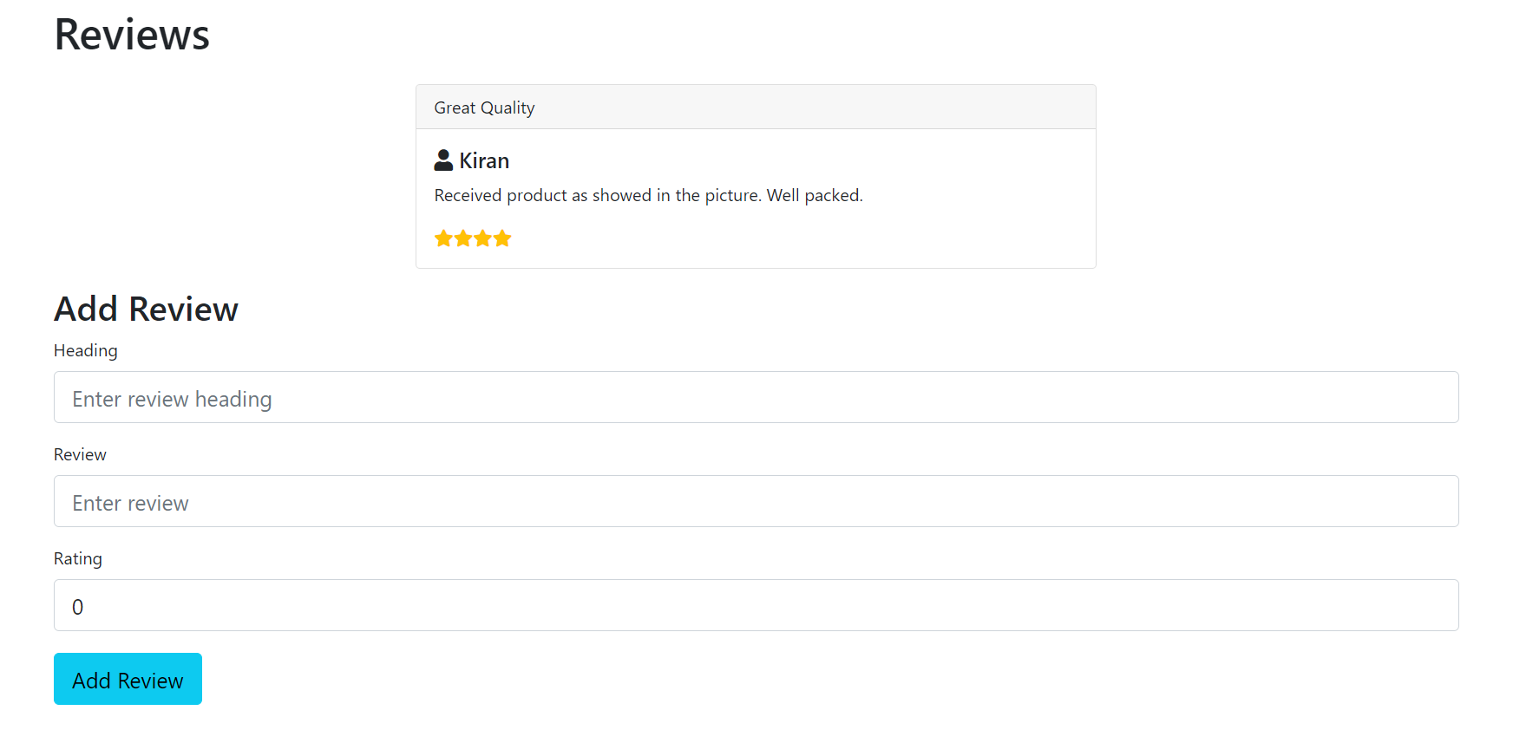
Reviews:

Slide 23
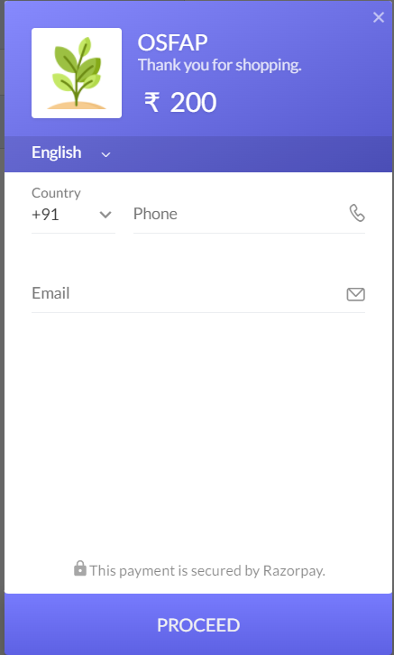
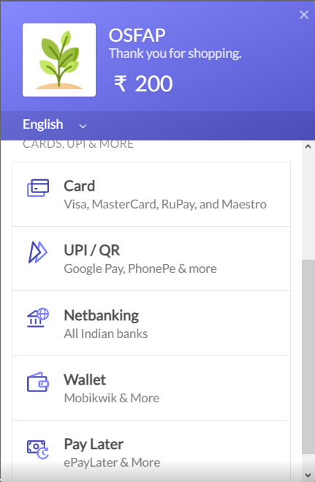
Payment Gateway:

Slide 24
FUTURE SCOPE
Selling all the products required for a plant to grow like soil, fertilisers
Return/replacement option for products
Free gifts, gardening guide for beginners
Subscription plans
Offers or vouchers
Delivery tracking

Slide 25
CONCLUSION
OSFAP is an online nursery that enables customers and vendors to buy or sell plants. This website includes useful information about the plants with images. It also allows customers to purchase rare plants.
Our website is user-friendly and caters for all plants. It provides various secured payment methods and there is no involvement of third party delivery. A review section is provided which helps customers to make decisions.
Our website can be further improved in the future by adding features like cancellation, returns/replacements and online tracking. Using this website we get one step closer towards building a sustainable, eco-friendly environment.

Slide 26
REFERENCES
http://www.theblogstarter.com/wordpress/?t202id=91264&c1=bingexactfreebegexp and&t202kw=how%20to%20develop%20a%20website%20using%20wordpress&msclkid=01a0bb99fd171bd7a0e0da04ed663bac
https://bubble.io/landing-page-webapp2?msclkid=130c92eca0fc120db41af371b08 d74f7&utm_source=bing&utm_medium=cpc&utm_campaign=Web-App-Alpha&utm_term=web%20development&utm_content=Web%20app
https://websitesetup.org/
https://www.elearningfreak.com/?msclkid=d3f30fe32da31a5869426e7e3cda6130
https://www.gardenguides.com/85767-types-plant-seeds.html
https://healthywaymag.com/diet-and-nutrition/types-of-seeds
https://app.diagrams.net

Slide 27
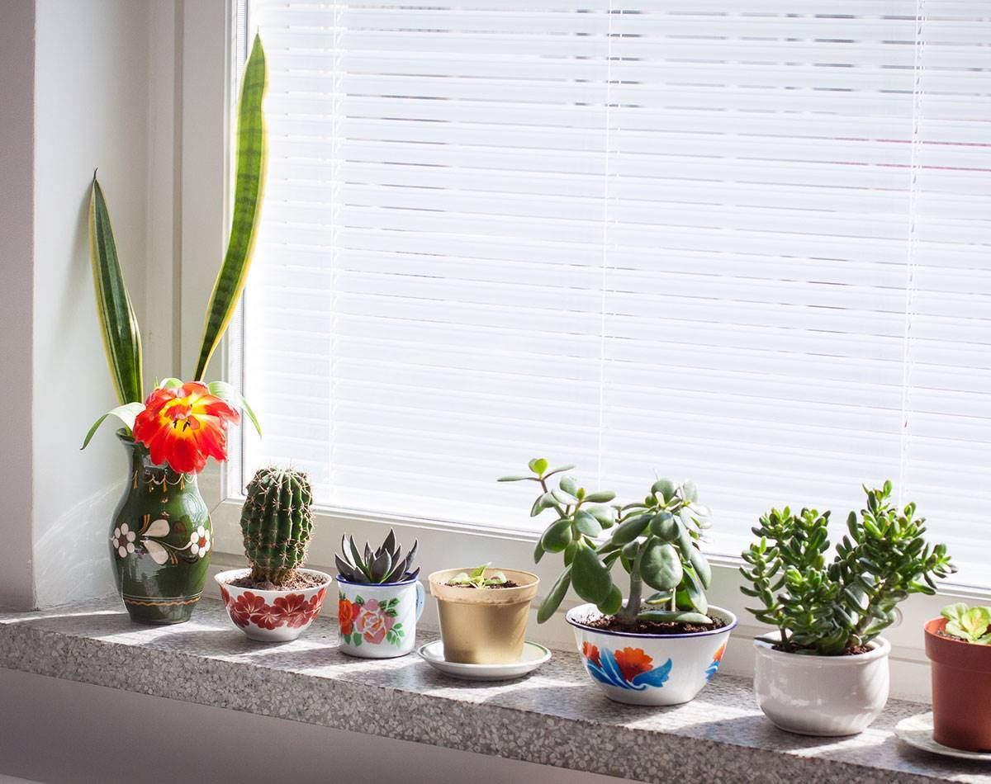
Thank You

